Slide 1
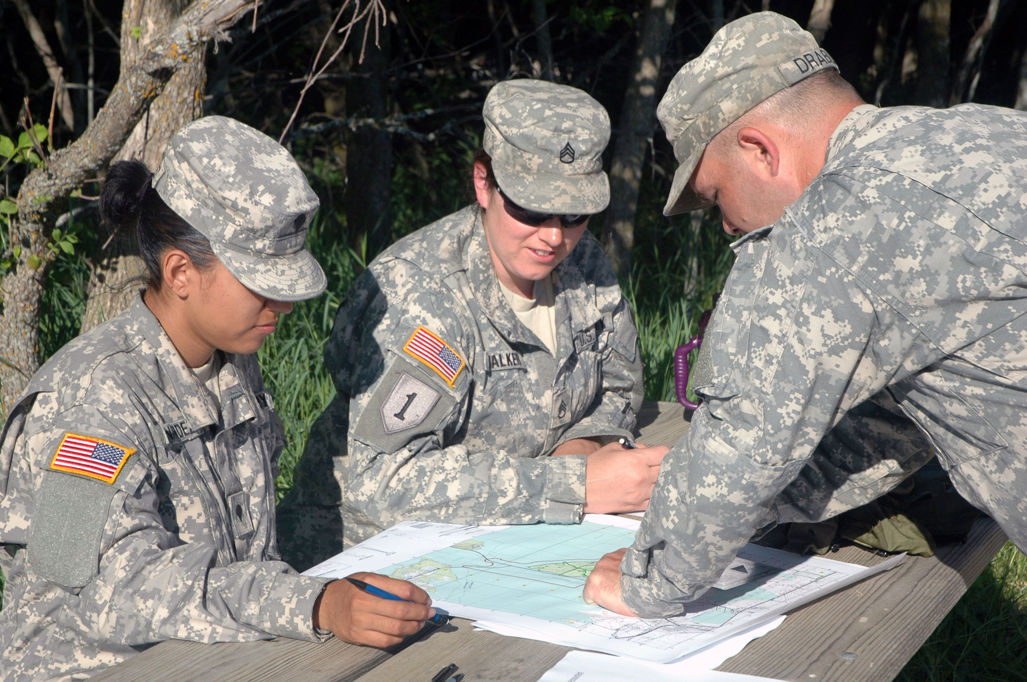
MAP READING

Slide 2
Terminal Learning Objective:
During this block of instruction you will receive training on identifying the major terrain features, minor terrain features, and colors found on a Military map. Demonstrate the ability to find a point on the map using a protractor and determine the elevation using contour lines on a Military map.

Slide 3
Action: Identify the major terrain features, minor terrain features, colors found on a Military map. Demonstrate the ability to find a point on the map using a protractor, determine the elevation using contour lines and determine distance on a Military Map.
Condition: In a classroom environment, given the student handouts, Prescribed Equipment and a writing utensil.
Standards: Achieve 100% on all the written exams as well as participate in the check on learning.

Slide 4
Safety: Low.
Risk: Low
Environmental Considerations: None; Classroom environment
Evaluation: You will be evaluated at the end of each block of instruction, and must receive a first time go on each evaluation. The evaluations will be written exams or in class exercises and you must correctly get 100% on each evaluation to pass.

Slide 5
Identify key terrain features on a
Military Map.

Slide 6
Action. Identify key terrain features on a map in 1 minute or less.
Condition: In a classroom environment, given a student handout and a writing utensil.
Standard: Demonstrate the ability to match the terrain feature pictured to the label on the left in 1 minute or less.

Slide 7
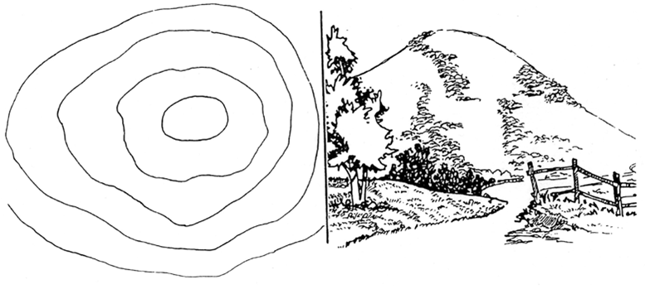

Slide 8
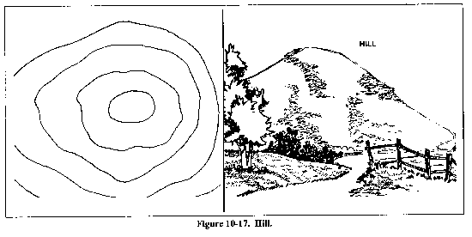
HILL: AN AREA OF HIGH GROUND. FROM
A HILLTOP, THE GROUND SLOPES DOWN IN
ALL DIRECTIONS.
Notes:
Contour lines forming concentric circles.

Slide 9
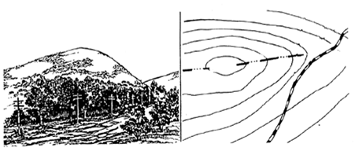

Slide 10
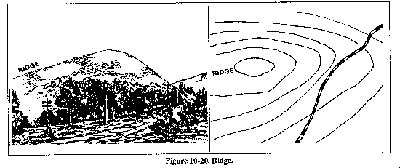
RIDGE: A SLOPING LINE OF HIGH GROUND.
Notes:
Contour lines forming a U or V; always point to high ground.

Slide 11
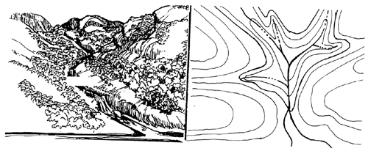

Slide 12
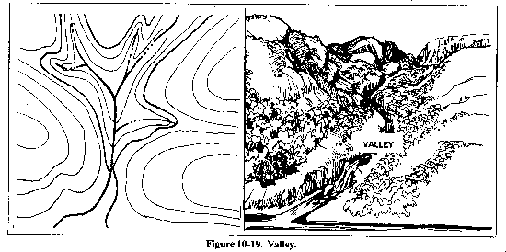
VALLEY: A STRETCHED-OUT GROOVE IN
THE LAND, USUALLY FORMED BY
STREAMS OR RIVERS.
Notes:
Contour lines form U lines tend to parallel stream before crossing.
Contour line crossing streams ALWAYS point up stream.
Usually plenty of room to maneuver

Slide 14
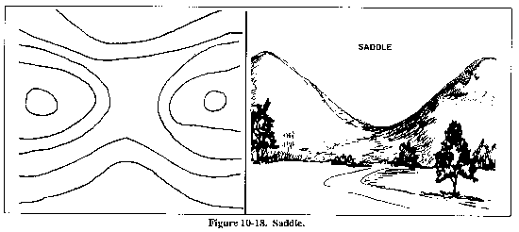
SADDLE: A DIP OR LOW POINT BETWEEN
TWO AREAS OF HIGHER GROUND.
Notes:
Between 2 hilltops or a break in the level crest of a ridge.
Saddle usually appear as an hourglass

Slide 16
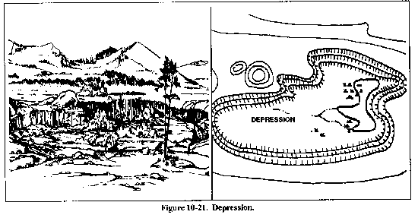
DEPRESSION: A LOW POINT IN THE GROUND
OR SINKHOLE. THEY ARE REPRESENTED BY CLOSE
CONTOUR LINES THAT HAVE TICK MARKS POINTING
TOWARD LOW GROUND.
Notes:
In a depression there is higher ground on ALL sides

Slide 17
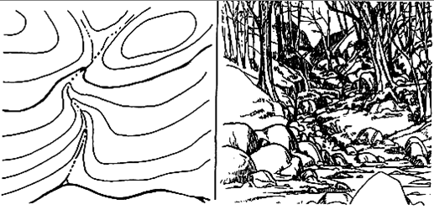

Slide 18
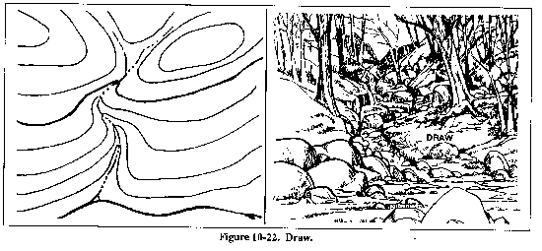
DRAW: A LESS DEVELOPED STREAM COURSE THAN A VALLEY. THERE IS ESSENTIALLY NO LEVEL GROUND AND, THEREFORE, LITTLE OR NO MANEUVER ROOM WITHIN ITS CONFINES.
Notes:
Contour lines are V Shaped with the points of the V POINTING UPHILL and UPSTREAM

Slide 19
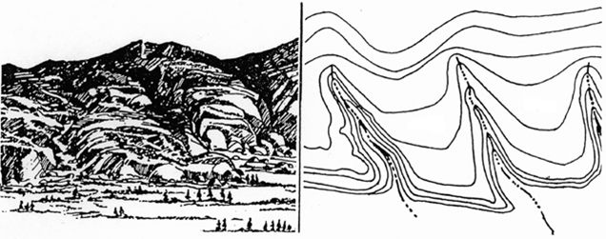

Slide 20
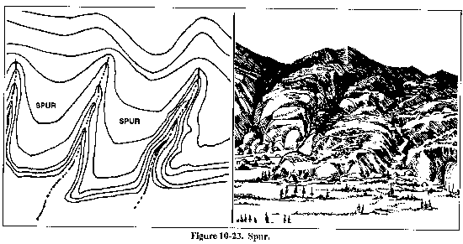
SPUR: A SHORT, CONTINUOUS SLOPING LINE OF HIGHER GROUND, NORMALLY JUTTING OUT FROM THE SIDE OF A RIDGE.
Notes:
ususally formed by parallel streams cutting down the side of a ridge
Contour lines shaped like U or Vs point AWAY From HIGH GROUND

Slide 21
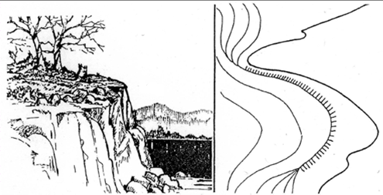

Slide 22
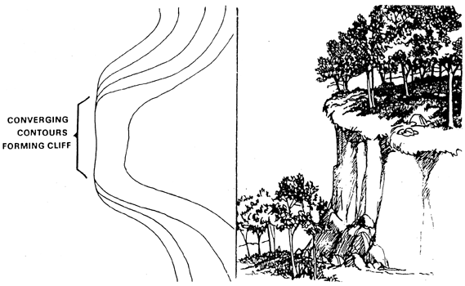

Slide 23
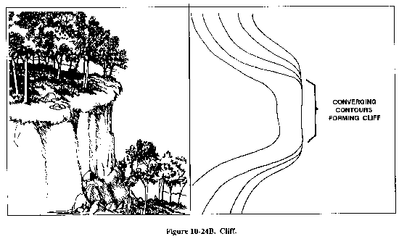
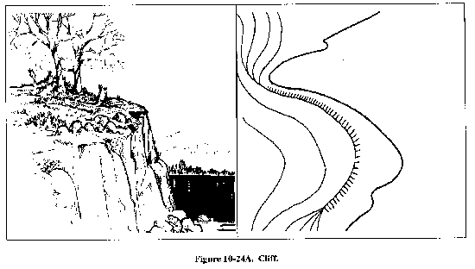
CLIFF: A VERTICAL OR NEAR VERTICAL FEATURE; IT IS AN ABRUPT CHANGE OF THE LAND. THE SLOPE IS SO STEEP THAT THE
CONTOUR LINES CONVERGE INTO ONE CONTOUR LINE OR THE LAST CONTOUR LINE HAS TICK MARKS POINTING TO LOW GROUND.

Slide 24
Terrain Features Test: (1 Minute)
You have 1 Minute to match the corresponding Terrain Feature pictured with the name in the left column.

Slide 25
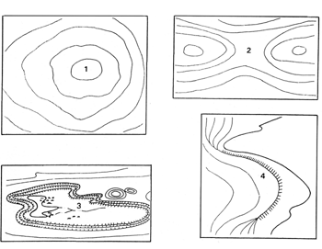
Terrain Features: Match the corresponding Terrain Feature pictured to the corresponding Terrain Feature.
1. .............Hill
2. .............Saddle
3. .............Depression
4. .............Cliff

Slide 26
Summary:
Review: During this lesson you have learned the key Terrain Features that will assist you on your way to becoming more proficient at Terrain Association.

Slide 27
Identifying the Colors found on a Military Map.

Slide 28
Action: Identify the Basic Colors found on a Military Map within 1 minute.
Condition: In a classroom environment, given a student handout and a writing utensil.
Standard: Demonstrate the ability to match the Basic Colors found on a Military Map to the Corresponding definition within 1 minute.

Slide 29
BLACK:
- Indicates cultural (man-made) features such as buildings and roads, surveyed spot elevations, and all labels

Slide 30
BLUE:
- Identifies water features such as lakes, swamps, rivers, and drainage

Slide 31
BROWN:
- Identifies all relief features and elevation, such as contours on older edition maps, and cultivated land on red-light readable maps

Slide 32
GREEN:
- Identifies vegetation with military significance, such as woods, orchards, and vineyards

Slide 33
RED:
- Classifies cultural features, such as populated areas, main roads, and boundaries on older maps

Slide 34
RED – BROWN:
- Combined to identify cultural features, all relief features, non-surveyed spot elevations, and elevation, such as contour lines on red-light readable maps

Slide 35
COLORS & DEFINITIONS:
Colors | Symbols
Black | Cultural (Man-Made features) other then roads, and water
Blue | Water
Brown | All relief features (minor roads and contour lines)
Green | Vegetation
Red | Major, Roads, and built up areas
Red-Brown | All relief features and roads on red light readable maps

Slide 36
Check on Learning:
What does the color Green represent on a map?
Vegetation
What does the color Brown represent on a map?
Contour Lines & all relief features
Name the Six colors generally found on a map?
Black, Brown, Blue, Green, Red, Red-Brown

Slide 37
Colors on a Map Test:
You have 1 minute to match the color found on a Military map to the corresponding definition.

Slide 38
Colors on a Map:
Colors | Symbols
Black | All relief features and roads on red light readable maps
Blue | Major roads and built up areas
Brown | Vegetation
Green | Cultural (Man-Made Features) other than roads and water
Red | All relief features (minor roads and contour lines)
Red-Brown | Water

Slide 39
COLORS & DEFINITIONS:
Colors | Symbols
Black | Cultural (Man-Made features) other then roads, and water
Blue | Water
Brown | All relief features (minor roads and contour lines)
Green | Vegetation
Red | Major, Roads, and built up areas
Red-Brown | All relief features and roads on red light readable maps

Slide 40
Summary:
Review: During this block of instruction you have learned how to identify the Basic Colors found on a Military Map.

Slide 41
Identifying a Grid Coordinate on a Military Map.

Slide 42
Action: Determine the grid coordinate within 100 meters of accuracy on a Military Map with in 10 minutes.
Condition: In a classroom environment, given a student handout (Map), Protractor (GTA 5-2-12) and a writing utensil.
Standard: Demonstrate the ability to identify the Military feature in the grid coordinate on a Military Map (Student Handout) within 10 minutes. Student must accurately get 4 out of 4 correct to receive a go.

Slide 43
Grid Coordinate Scales. (Protractor)
The primary tool for plotting grid coordinates is the grid coordinate scale. The grid coordinate scale divides the grid square more accurately than can be done by estimation, and the results are more consistent and accurate.
Nomenclature:
(GTA 5-2-12)

Slide 44
This device will include at least two coordinate scales, 1:25,000 and 1:50,000 meters. Make sure that when you use this device, you use the correct scale.

Slide 45
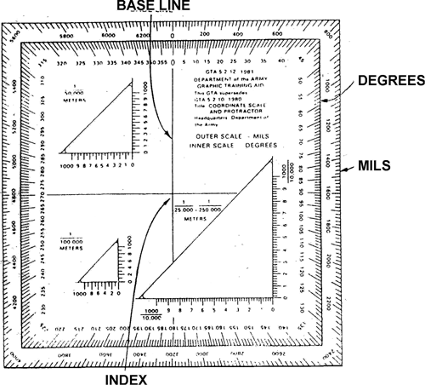
Military Coordinate Scale and Protractor
1/ 50,000
→
1/25,000
←
1/100,000
→

Slide 46
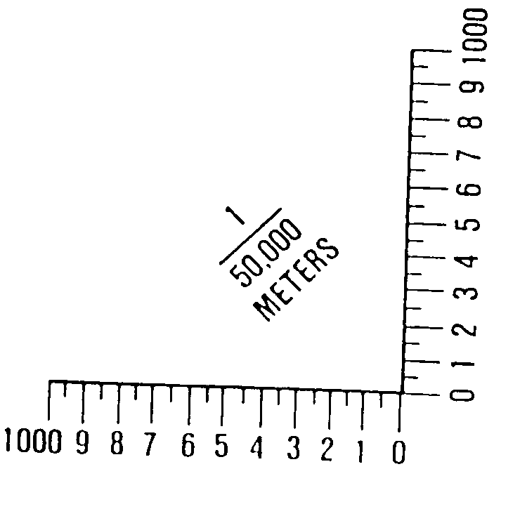
We use this scale for most Military Land Navigation Courses.

Slide 47
When reading the protractor each half tick mark equals half of that number. So you will have to estimate if the point does not line up flush with the tick marks.

Slide 48
Note.
1. A military map can help you spot your location accurately. The map has vertical lines (top to bottom) and horizontal lines (left to right). These lines form small squares 1,000 meters on each side, called grid squares. 2. The lines that form grid squares are numbered along the outside edge of the map picture. No two grid squares have the same number. 3. The precision of a point location is shown by the number of digits in the coordinates; the more digits, the more precise the location. For example: 1996—A 1,000-meter grid square. 192961—To the nearest 100 meters.

Slide 49
How close a Grid Coordinate can get you.
4 DIGIT GRID COORDINATE TO WITHIN 1,000 METERS
A 6 DIGIT GRID COORDINATE TO WITHIN 100 METERS
A 8 DIGIT GRID COORDINATE TO WITHIN 10 METERS (50 METER TOLERANCE)

Slide 50
You have to read the Map from the Right and Up!
This means starting from the bottom Left Hand Side. Read Right to the Grid Line PRIOR TO your Target and then UP TO the Grid line Prior to your Target.

Slide 51
Grid Zone Designator
EH
12
00
01
00
99
98
154
X
10 11 12 13

Slide 52
Most Military Grid Coordinates are at least 8 Digit Grid Coordinates. The same principals apply as the 6 Digit Grid Coordinate except you will have to break down the numbers on the protractor to nearest amount. For example: The six digit grid coordinate reads 18N 395783. The 8 Digit Grid Coordinate would read 18N 39557835. You will place the Protractor on the point and read where the Grid Line intersects the protractor and where the center of the point intersects the Protractor.

Slide 53
Proper Steps to Use Protractor:
1. Locate the grid square in which the point is located ; the point should already be plotted on the map.
2. The number of the vertical grid line on the left side of the grid square gives the first and second digits of the coordinate.

Slide 54
3. The number of the horizontal grid line on the bottom side of the grid square gives the fourth and fifth digits of the coordinate.
4. Place a coordinate scale on the bottom horizontal grid line of the grid square containing the point to determine the third and sixth digits of the coordinate.
5. Check to see that the zeros of the coordinate scale are in the lower right-hand corner of the grid square where the point is located.

Slide 55
6. Slide the scale to the right, keeping the bottom of the scale on the bottom grid line until the point is under the vertical (right-hand) scale. To determine the six-digit coordinate, the 100-meter mark on the bottom scale, which is nearest the vertical grid line, is the third digit of the number 395. The 100-meter mark on the vertical scale, which is nearest to the point, is the sixth digit of the number 783. Putting these together, you have 395783.

Slide 56
2 Letter Grid Identifier:
To determine the correct two-letter 100,000-meter-square identifier, look at the grid reference box in the margin of the map. Place the 100,000-meter-square identifier in front of the coordinate.
Example: VP 611572

Slide 57
Check on Learning:
How close will a 6 Digit Grid Coordinate get to a point on the map?
100 Meters
How do you read a Map?
Right and Up
What goes before any Grid Coordinate?
Grid Zone Identifier
How do you read a Protractor?
Right and Up

Slide 58
Grid Coordinate Test:
You will have 10 minutes to correctly identify the Military feature in the correct grid coordinate on a Military Map (Student Handout). Student must accurately get 4 out of 4 correct to receive a go.

Slide 59
Grid Coordinate Test:
What is located at Grid 18TVP 39357920?
NBC Facility
2. What Man Made feature is located at Grid 18TVP 37157635?
Intersection of Po Valley & Conway
3. What is the 6 Digit Grid Coordinate to the Confidence Course?
18TVP 401779
4. What is the 6 Digit Grid Coordinate to Hilltop 141?
18TVP 388777

Slide 60
Summary:
During this block of instruction you have received training on how to find a point using a 6 & 8 Digit Grid Coordinate on a Military Map.

Slide 61
Determine the Distance on a Military Map using Contour Intervals and measurements.

Slide 62
Action: Determine the distance between counter intervals and ground distance on a Military Map.
Condition: In a classroom environment, given a student handout (Map), Protractor (GTA 5-2-12), Military Map (Student Handout) and a writing utensil.
Standard: Demonstrate the ability to identify the distance between contour intervals and ground distance on a Military Map with 100% accuracy. The Soldier must accurately answer 4 out of 4 check on learning questions as well as identify the correct contour measurements.

Slide 63
CONTOUR INTERVALS:
Before the elevation of any point on the map can be determined, the user must know the contour interval for the map he is using. The contour interval measurement given in the marginal information is the vertical distance between adjacent contour lines. To determine the elevation of a point on the map—
Determine the contour interval and the unit of measure used, for example, feet, meters, or yards.

Slide 64
You can find this in the Marginal Information of your Map. It will look like the example below.

Slide 65
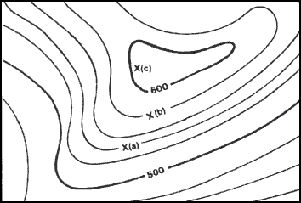
Find the numbered index contour line nearest the point of which you are trying to determine the elevation

Slide 66
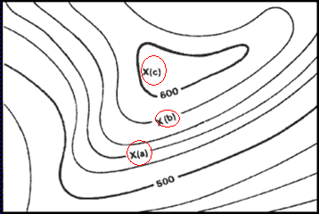
Determine if you are going from lower elevation to higher, or vice versa. In figure below, point (a) is between the index contour lines. The lower index contour line is numbered 500, which means any point on that line is at an elevation of 500 meters above mean sea level. The upper index contour line is numbered 600, or 600 meters. Going from the lower to the upper index contour line shows an increase in elevation.

Slide 67
Determine the exact elevation of point (a), start at the index contour line numbered 500 and count the number of intermediate contour lines to point (a). Locate point (a) on the second intermediate contour line above the 500-meter index contour line. The contour interval is 20 meters , thus each one of the intermediate contour lines crossed to get to point (a) adds 20 meters to the 500-meter index contour line. The elevation of point (a) is 540 meters; the elevation has increased.

Slide 68
Determine the elevation of point (b). Go to the nearest index contour line. In this case, it is the upper index contour line numbered 600. Locate point (b) on the intermediate contour line immediately below the 600-meter index contour line. Below means downhill or a lower elevation. Therefore, point (b) is located at an elevation of 580 meters. Remember, if you are increasing elevation, add the contour interval to the nearest index contour line. If you are decreasing elevation, subtract the contour interval from the nearest index contour line.

Slide 69
Determine the elevation to a hilltop point (c). Add one-half the contour interval to the elevation of the last contour line. In this example, the last contour line before the hilltop is an index contour line numbered 600. Add one-half the contour interval, 10 meters, to the index contour line. The elevation of the hilltop would be 610 meters.

Slide 70
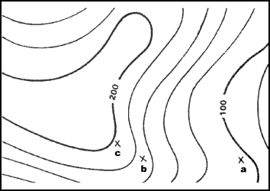
There may be times when you need to determine the elevation of points to a greater accuracy. To do this, you must determine how far between the two contour lines the point lies. However, most military needs are satisfied by estimating the elevation of points between contour lines

Slide 71
If the point is less than one-fourth the distance between contour lines, the elevation will be the same as the last contour line. In the previous figure, the elevation of point a will be 100 meters. To estimate the elevation of a point between one-fourth and three-fourths of the distance between contour lines, add one-half the contour interval to the last contour line.

Slide 72
Point b is one-half the distance between contour lines. The contour line immediately below point b is at an elevation of 160 meters. The contour interval is 20 meters; thus one-half the contour interval is 10 meters. In this case, add 10 meters to the last contour line of 160 meters. The elevation of point b would be about 170 meters.

Slide 73
A point located more than three-fourths of the distance between contour lines is considered to be at the same elevation as the next contour line. Point c is located three-fourths of the distance between contour lines. In the previous figure, point c would be considered to be at an elevation of 180 meters.

Slide 74
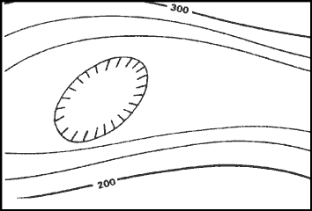
To estimate the elevation to the bottom of a depression, subtract one-half the contour interval from the value of the lowest contour line before the depression. In the figure pictured, the lowest contour line before the depression is 240 meters in elevation. Thus, the elevation at the edge of the depression is 240 meters. To determine the elevation at the bottom of the depression, subtract one-half the contour interval. The contour interval for this example is 20 meters. Subtract 10 meters from the lowest contour line immediately before the depression. The result is that the elevation at the bottom of the depression is 230 meters. The tick marks on the contour line forming a depression always point to lower elevations.

Slide 75
In addition to the contour lines, bench marks and spot elevations are used to indicate points of known elevations on the map.
(1) Bench marks, the more accurate of the two, are symbolized by a black X, such as X BM 214. The 214 indicates that the center of the X is at an elevation of 214 units of measure (feet, meters, or yards) above mean sea level. To determine the units of measure, refer to the contour interval in the marginal information.
(2) Spot elevations are shown by a brown X and are usually located at road junctions and on hilltops and other prominent terrain features. If the elevation is shown in black numerals, it has been checked for accuracy; if it is in brown, it has not been checked.

Slide 76
Measuring Distance on a Military Map:
STRAIGHT-LINE DISTANCE:
To determine straight-line distance between two points on a map, lay a straight-edged piece of paper on the map so that the edge of the paper touches both points and extends past them. Make a tick mark on the edge of the paper at each point.

Slide 77
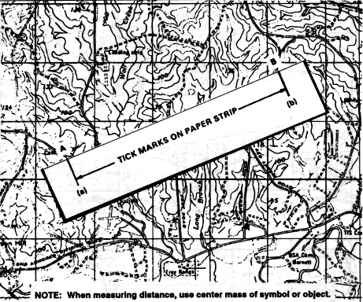
STRAIGHT-LINE DISTANCE

Slide 78
STRAIGHT-LINE DISTANCE
To convert the map distance to ground distance, move the paper down to the graphic bar scale, and align the right tick mark with a printed number in the primary scale so that the left tick mark is in the extension scale
1000
500
0
1000
2000
3000
4000
5000
METERS

Slide 79
Example:
1000
500
0
1000
2000
3000
4000
5000
METERS
3350 meters

Slide 80
CURVED-LINE DISTANCE
To measure distance along a road, stream, or other curved line, the straight edge of a piece of paper is used. In order to avoid confusion concerning the point to begin measuring from and the ending point, an eight-digit coordinate should be given for both the starting and ending points. Place a tick mark on the paper and map at the beginning point from which the curved line is to be measured. Align the edge of the paper along a straight portion and make a tick mark on both map and paper when the edge of the paper leaves the straight portion of the line being measured.

Slide 81
CURVED-LINE DISTANCE

Slide 82
CURVED-LINE DISTANCE
Keeping both tick marks together (on paper and map), place the point of the pencil close to the edge of the paper on the tick mark to hold it in place and pivot the paper until another straight portion of the curved line is aligned with the edge of the paper. Continue in this manner until the measurement is completed.

Slide 83
CURVED-LINE DISTANCE

Slide 84
CURVED-LINE DISTANCE
When you have completed measuring the distance, move the paper to the graphic scale to determine the ground distance. The only tick marks you will be measuring the distance between are tick marks (a) and (b). The tick marks in between are not used.

Slide 85
Check on Learning
Where can you find the Countour Interval on the Map?
The Marginal Information
How can you determine the elevation to the bottom of a depression?
Subtract ½ the contour interval from the value of the lowest contour line before the depression.
How are Spot Elevations represented on a Military Map?
Shown by a Brown X and are usually located at road junctions and on hilltops and other prominent terrain features.
How can you determine the elevation of a hilltop?
Add ½ the contour interval to the elevation of the last contour line.

Slide 86
DETERMINING ELEVATION CONTOUR INTERVAL IS 20M
10
1
2
3
400
5
4
400
9
6
300
8
7
1. 370
2. 410
3. 440
4. 350
5. 355
6. 345
7. 260
8. 290
9. 330
10. 370

Slide 87
Summary:
Review: During this block of instruction you have learned the ability to determine elevation using contour intervals and measure ground distance on a Military Map.

